Slide 1
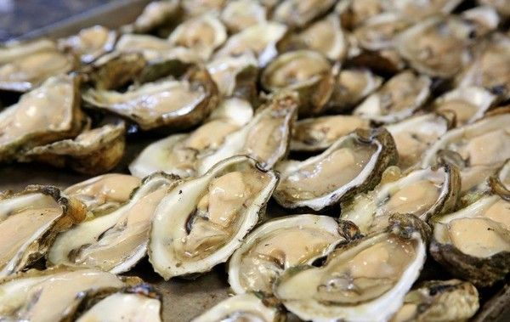
2024 Hampton Roads ALA Golf and Oyster Roast Chuck Johnson Memorial
Hampton Roads
Tuesday, October 15th, 2024
Day before National ALA Conference
Red Wing Golf Course – Virginia Beach, VA
Golf 8:15 tee time – Oyster Roast/Lunch at 1:00
Limited to 128 golfers
Please sign up and remit payment by October 1st
Oyster Roast Only
$25 / $20 HR ALA Members
Golf and Oyster Roast
$85 / $80 HR ALA Members
Circle one
Name: | Company:
E-mail: | Phone:
SPONSORSHIP OPPORTUNITIES Commitment needed by September 24th Hole ($150) / Banner ($500)
Sponsorship Name: | Company Contact:
Payment Options:
In advance by credit card: Contact Marc Michals (marc@mvp-marketing.com)
In advance by check: Make payable to Hampton Roads ALA and send to Paul Wehner
813 Tluchak Lane, Chesapeake, VA 23323
In person at the event: Cash or Credit Card
Please send all Oyster Roast registrations to POCs below
David Gretz | 757-831-5233 | dgretz@eurpac.com
Paul Wehner | 757-619-9396 | paul.wehner@mrsbc.org

Slide 2
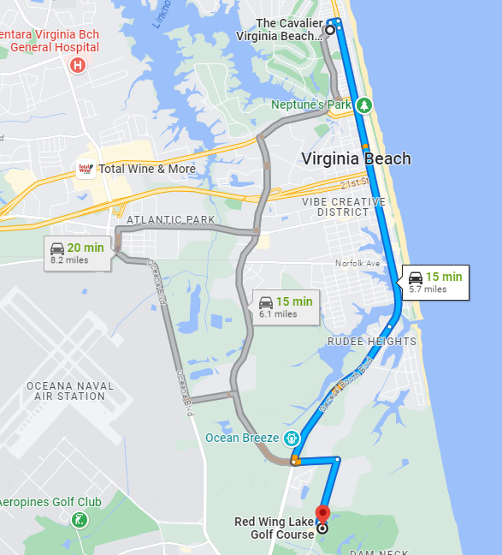
Hampton Roads
ANNUAL GOLF TOURNAMENT
AND OYSTER ROAST
Golf & Oyster Roast Lunch: Redwing Golf Course
1144 Prosperity Rd, Virginia Beach, VA 23451
2024 ALA National Convention Hotel: Marriott Virginia Beach Oceanfront 42nd St.
GOLF & LUNCH
Red Wing Golf Course

